Slide 1
The Boring Club Week 5

Slide 2
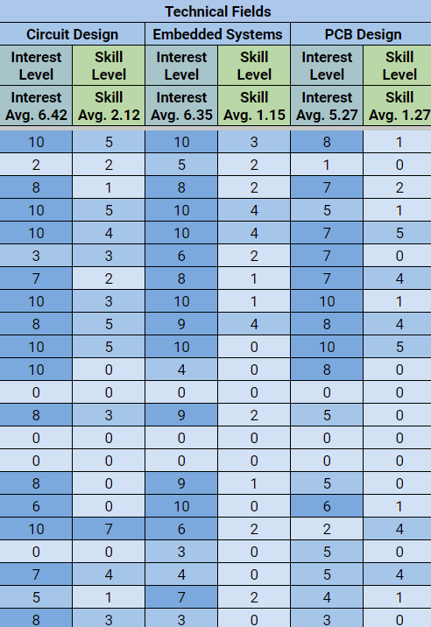
Spreadsheet
Do your check-in right now
This is how I will give Google Drive access to members
Does anyone need access?

Slide 3
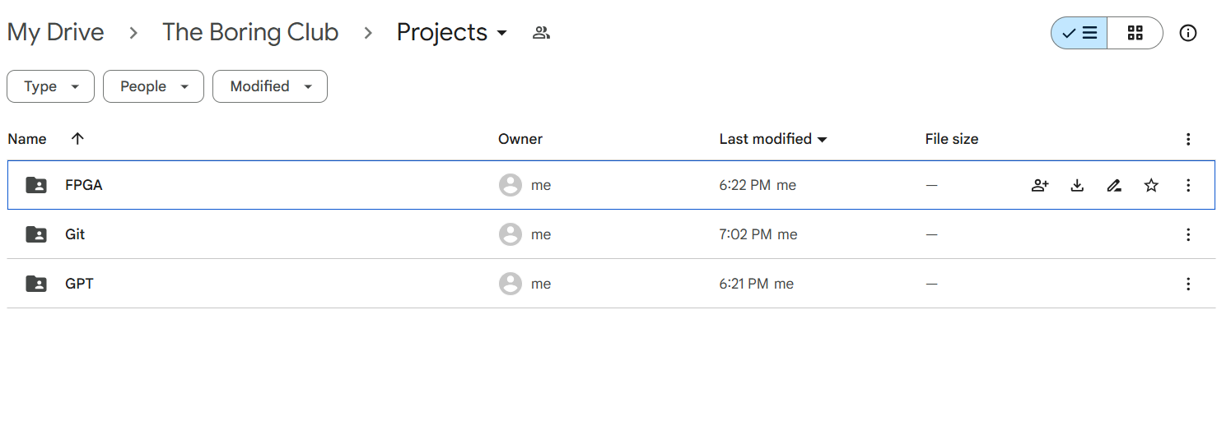
Google Drive
We keep project materials in the Projects folder
You can also find code, schematics, old meeting slides, etc.

Slide 4
Project Status Reports

Slide 5
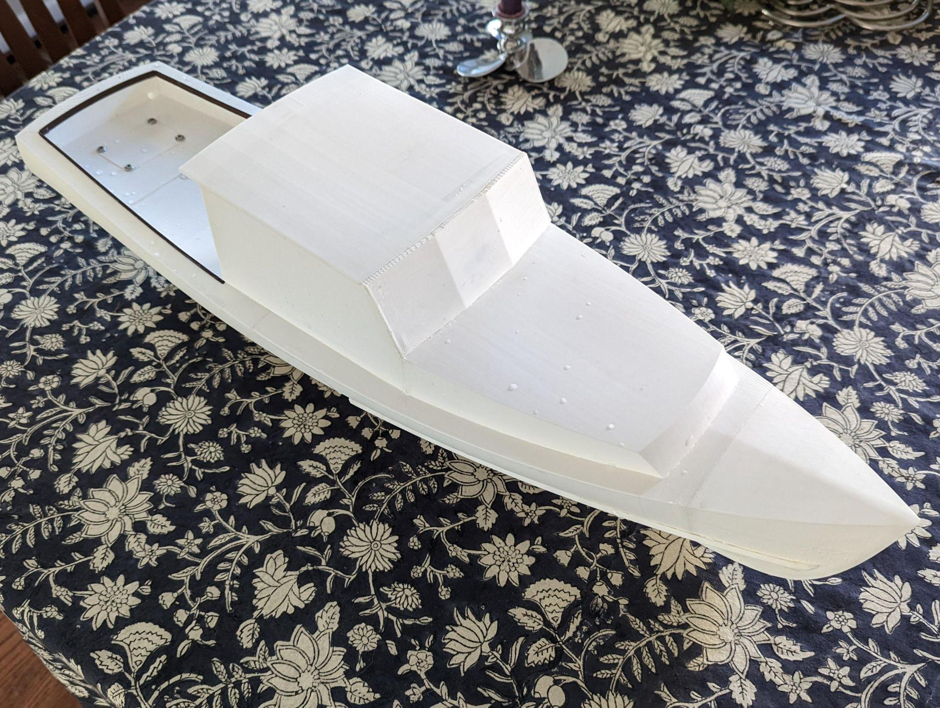
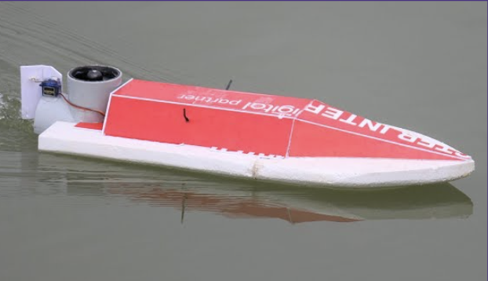
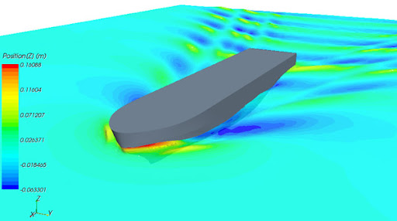
Mini Motorboat (Arjun and Zi)
Last week: Split into sub teams
Discussed a traditional RC boat design and a center design
Electrical: learned how to use a breadboard

Slide 6


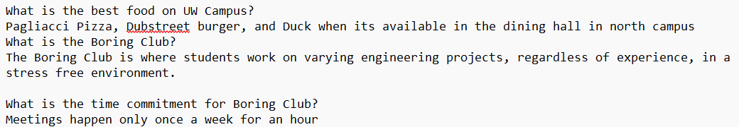
UW GPT (Arshan)
Questions GPT should handle (classes, intramurals, etc.)
Uploading Text Files to GPT (Q&A)
Finding ways to navigate Dawgpath w/JavaScript

Slide 7

Github/Git (Sean)
How Git works

Slide 8
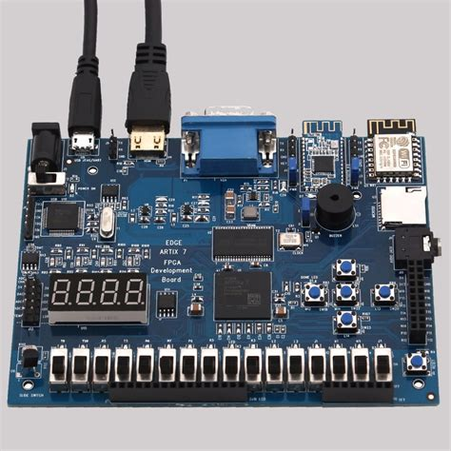
FPGA Digital System Sim (Sam)
Last week reviewed boolean algebra, gates, Karnaugh Maps (K-maps) and intro to system design
This week we will set up sim environment and learn some Verilog programming

Slide 9
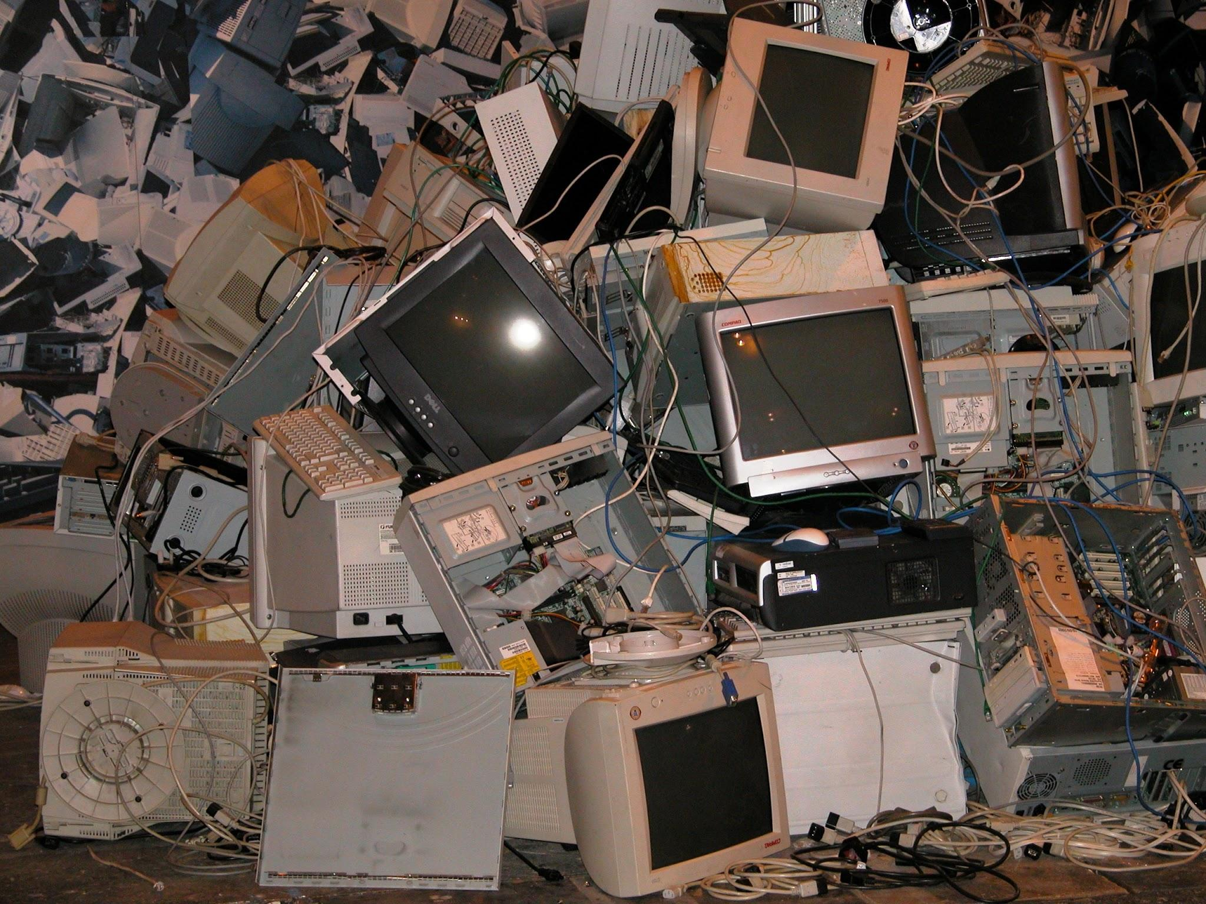


Projects
Let’s get to work!
Notes:
Josh talk about Bot if finished?

